Slide 1
Generators

Slide 2
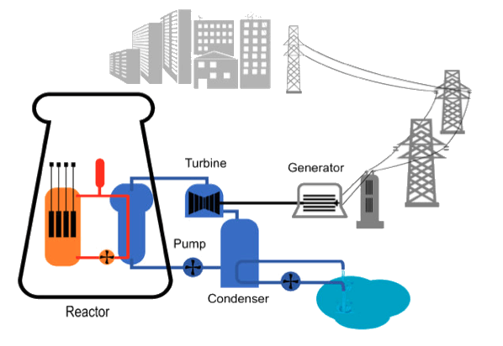
By the end of this Smart Lesson, you should be able to:
Explain what a generator is.
Summarise how generators use electromagnetic induction.
Outline some examples of systems that use generators.

Slide 3
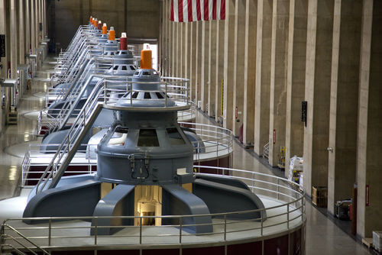
A generator is a device that transforms mechanical energy into electrical energy.
Mechanical energy includes potential energy (energy that is stored in objects) and kinetic energy (energy of moving objects).
Electrical energy is the energy associated with electricity.
Very simply, this means that generators turn movement and stored energy into electricity.

Slide 4
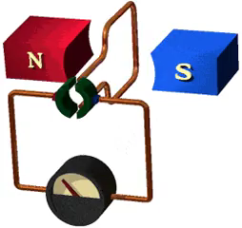
Generators use electromagnetic induction to transform mechanical energy into electrical energy.
One way of doing this is to spin a loop of wire inside a constant magnetic field. This generates a current inside the wire.
The other method is to turn a magnet inside a wire loop. Since the magnetic field changes as the magnet rotates, this also generates a current in the wire.

Slide 5
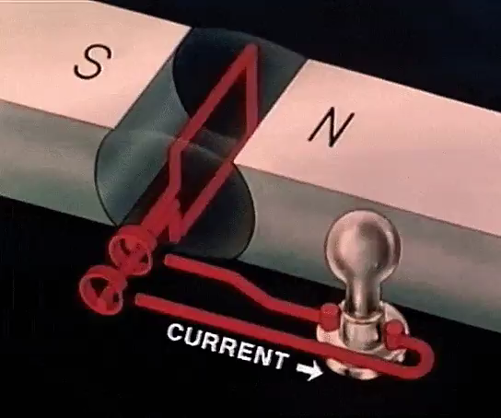
These generators produce AC electricity.
This means that the current changes the direction it travels in many times each second. AC stands for "Alternating Current" and it is the type of electricity that comes from a power socket.
The other type of electricity that can be used is DC electricity, which stands for "Direct Current". The current only travels in one direction in this system.
One advantage of AC over DC is that we can use a device called a transformer to easily change the voltage of an AC current. This can not be done with DC power.

Slide 6
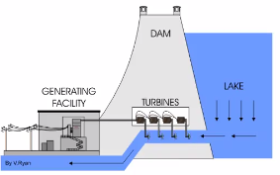
Hydroelectric dams use generators to produce AC electricity.
They produce 70% of the world's renewable energy and produce 7% of Australia's power, so they are very important!
These dams store a lot of water in the reservoirs behind them. The water is then forced through a tube near the base of the dam (called the penstock) into an outflow river. The quickly moving water rotates a turbine in the penstock.
The turbine's shaft extends up to the generator. This means that when the turbine rotates, the magnet or loop of wire also rotates, so electricity is produced.

Slide 7
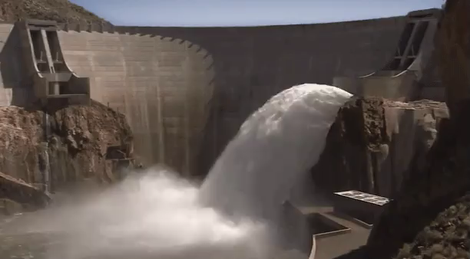
Most of the electrical energy produced by hydroelectric dams comes from the potential energy of the water.
The water in the reservoir is much higher than the water in the outflow river. This means that the water in the reservoir has more gravitational potential energy than the water in the outflow lake.
As the water flows past the turbine, the difference in gravitational potential energy is transferred to the turbine. The turbine and generator then transform this energy into electrical energy.

Slide 8
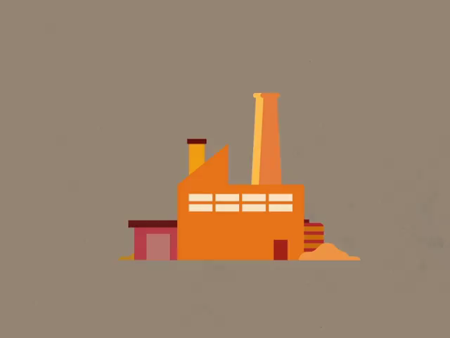
Coal power plants are very important in Australia - they provide 69% of our electricity!
First, coal is burnt in the furnace. Similar power plants burn oil or natural gas in the furnace to produce electricity. The boiler is above the furnace, so the heat released from the burning fuel boils the water in the boiler, producing steam.
The steam then rushes past a turbine, spinning its blades. The steam enters the turbine when it is very fast and hot and leaves when it is slow and cold so that maximum energy is transferred to the turbine.

Slide 9
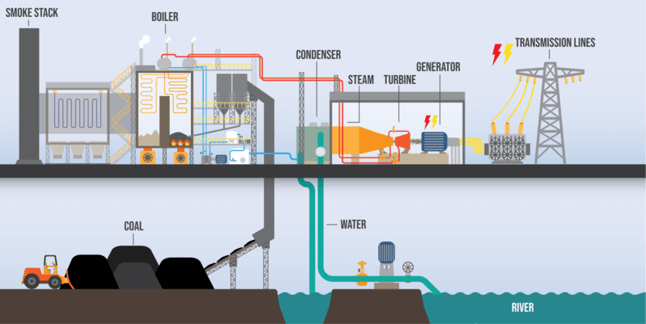
In a coal powerstation, a turbine is linked to the generator.
As the turbine spins, the generator also turns and generates electricity. Power pylons then carry the electricity to your home so that you can use it.
This means that the chemical potential energy in the coal is transformed into kinetic energy and heat energy and transferred to the steam. As the steam spins the turbine, all this energy is transformed into kinetic energy and transferred to the turbine.
The turbine then transfers this kinetic energy to the generator, which transforms it into electrical energy.

Slide 10
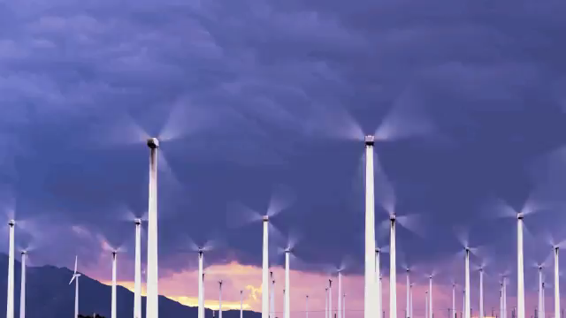
Wind power is another very important energy source in Australia, as they make up about 30% of our renewable energy and 5% of our total electricity.
A wind farm is made up of wind turbines. These turbines look kind of like giant fans and have three blades each.
When the wind blows, it spins the turbines. The shaft of the turbine is connected to the generator, so the generator produces electricity when the turbine turns.
This means that the kinetic energy of the wind is transferred to the turbine, which then transfers the energy to the generator. The generator then transforms this kinetic energy into electrical energy.

Slide 11

Nuclear power is a significant power source in many parts of the world. It is not used in Australia, but it provides around 11% of the world's electricity.
Nuclear reactors are actually very similar to coal power plants. The nuclear fuel (usually uranium) undergoes a special reaction called nuclear fission that releases heat. This heat is then used to boil water in the reactor vessel surrounding the nuclear fuel.

Slide 12
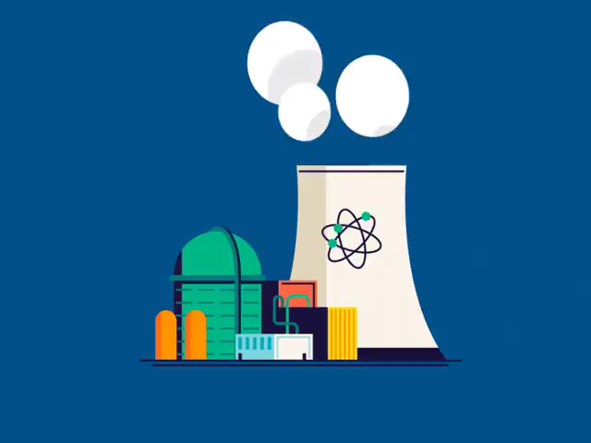
The steam produced from the boiling water is used to spin a turbine, just like in a coal power plant.
The turbine and generator are connected, so electricity is produced when steam spins the turbine.
Therefore, the chemical potential energy in uranium is transformed into kinetic energy and heat energy and transferred to the steam. The energy is then transferred to the turbine and transformed into kinetic energy. The turbine then transfers the kinetic energy to the generator, which transforms it into electrical energy.

Slide 13
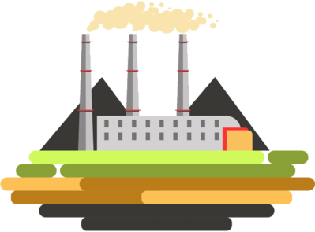
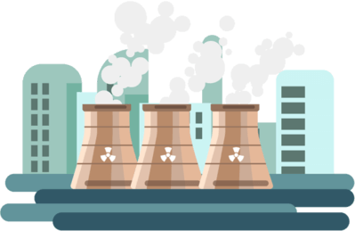
The big difference between coal power plants and nuclear reactors is that coal is burnt to produce heat and uranium undergoes nuclear fission.
After uranium undergoes nuclear fission, radioactive by-products are produced. These by-products need to be stored for thousands of years so that they don't harm people or the environment.

Slide 14
Nuclear fission needs to be very carefully controlled in nuclear power plants.
If the reaction gets out of control, there could be an enormous explosion that would release dangerous nuclear by-products into the environment.
For these reasons, Australia has decided not to use nuclear power. It's possible that in the future we might use nuclear power to produce electricity like Japan and the USA (for example), but we probably won't use it unless we absolutely have to.

